Slide 1

A deep Dive into Craft Beer data: A Cure For What Ales You
By: Alissa Trujillo
Notes:
Good afternoon, everyone, my name is Alissa and today we will be discussing a number of topics in the realm of Craft Beer. We will be taking an inside look at some interesting open-sourced beer review data and learning a little about the brewing process as well.

Slide 2
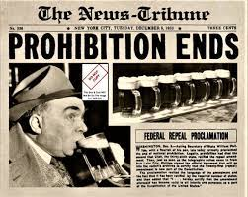
The History of craft beer
European Roots
Prohibition
Fritz Maytag and America’s First Porter
The Rise of Homebrewing
Notes:
The Craft Beer movement in America began with our European ancestors who immigrated here in the early days of our country. Traditional European beers contained just a few, very simple ingredients. These beers were brewed with high-quality homegrown grains and hops.
Unfortunately, this art was soon put to a halt with the introduction of prohibition. Due to the legality of the situation, it became increasingly difficult to grow quality ingredients and of course brew alcoholic beverages. When prohibition ended, beer production resumed, but the art of authentic European brewing was lost. The quality ingredients were replaced with cheap alternatives, such as corn and rice, resulting in what we know now as “lite beers” which are the large batch beers produced by large companies such as Coors and Anheuser-Busch.
The craft beer movement was reinvigorated a few decades later by Fritz Maytag, of Maytag appliance fame, who decided to make an investment in his favorite brewery: Anchor Brewing Co. in San Francisco, California to save it from going out of business. This inspired other investors to finance the market and revive the industry. Though he initially intended on just being involved financially, he ended up experimenting with brewing techniques. Fritz was instrumental in the creation of the nation’s first “craft beers”, beginning with the very first American porter.
After this boom, homebrewing was legalized and the homebrewing movement took off and we never looked back. Craft beer is such an integral piece of American history and the industry has been growing exponentially over the last few decades. There are more styles that exist now than our ancestors could ever dream of.

Slide 3
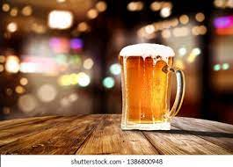
Problem Statements
Can we use craft beer data to create a clustering model that makes meaningful connections and distinctions between beers? Which qualities are most important to creating these distinctions?
Is a model able to differentiate, down to a high level of precision, a beer’s style using its inherent qualities? What features are most useful to making this determination?
Notes:
We will be taking a look at two different problem statements today:
The first: Can we use craft beer data to create a clustering model that makes meaningful connections and distinctions between beers? Which qualities are most important to creating these distinctions?
And the second: is a model able to differentiate, down to a high level of precision, a beer’s style using its inherent qualities? What features are most useful to making this determination?

Slide 4
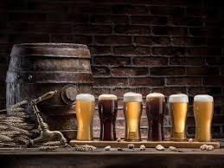
Problem significance
Audiences:
Consumers
Bartenders
Brewers
Notes:
Using existing data regarding craft beer, we will be able to create models that assist consumers, bartenders and brewers in their creation and consumption of craft beer.
By gaining in-depth insight regarding beer styles and flavor profiles, we will be able to assist consumers in finding beers similar to the ones they already enjoy.
It will allow our bartenders to make recommendations more easily, as well as providing them a deeper understanding of the beers they serve.
Our brewers will be able to understand the broader trends in the industry and use these models to help determine which flavor profiles to experiment with.

Slide 5
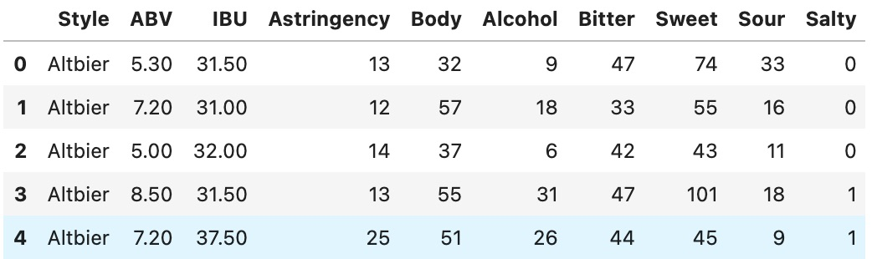
The Dataset
The dataset is titled ”Beer Profiling and Ratings Data Set” and is sourced from Kaggle
25 columns, with detailed information about each beer’s taste profiles
3197 rows, each representing an individual beer
Notes:
The dataset we will be looking at is titled “Beer Profile and Ratings Dataset” and is sourced from Kaggle
This dataset explores reviews of a number of craft beers, with detailed information about their flavor profiles. The dataset has 25 columns, including ABV (alcohol by volume), IBU (international bitterness units, the measure of a beverage’s bitterness), and flavor notes of the brew. We can see a small selection of these features in the photo: bitterness, sweetness, sourness and saltiness just to name a few.
There are 3197 rows, each presenting information pertaining to an individual beer

Slide 6
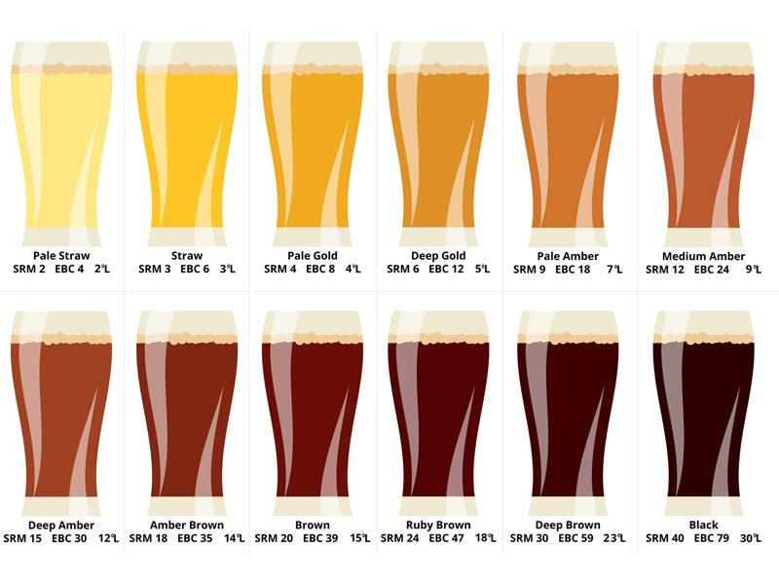
Data Exploration
Removing Unnecessary Features
Fixing the IBU values
Consolidating the Style Variable
Notes:
The dataset thankfully only needed a few tweaks to make it model-ready
I removed some columns that were unnecessary for our analysis. The columns representing the beer’s name, the brewery’s name and the description were removed. I also got rid of the columns detailing review information. The original model I created ended up clustering data only by good review vs. bad review, which does not help us address our problem statements. The distinctions should be based on only inherent features of the beers themselves rather than review score.
The IBU feature was represented initially by a range of values for each beer, so this information has been consolidated into a single number, calculated as the mean of this range.
The last, and most important step, in preparing data for analysis is consolidating the Style variable. This column initially contained 111 unique values, which has been pared down to 43 styles. Initially, there were separate entries for, as an example, English Stout, Oatmeal Stout and Russian Imperial Stout. These have all been consolidated to a single stout category. Since we intend on creating a model that predicts class membership for each style, having 43 options to choose from creates a much more streamlined process. Though this is still a large number, it will be easier to navigate for our classification model.

Slide 7
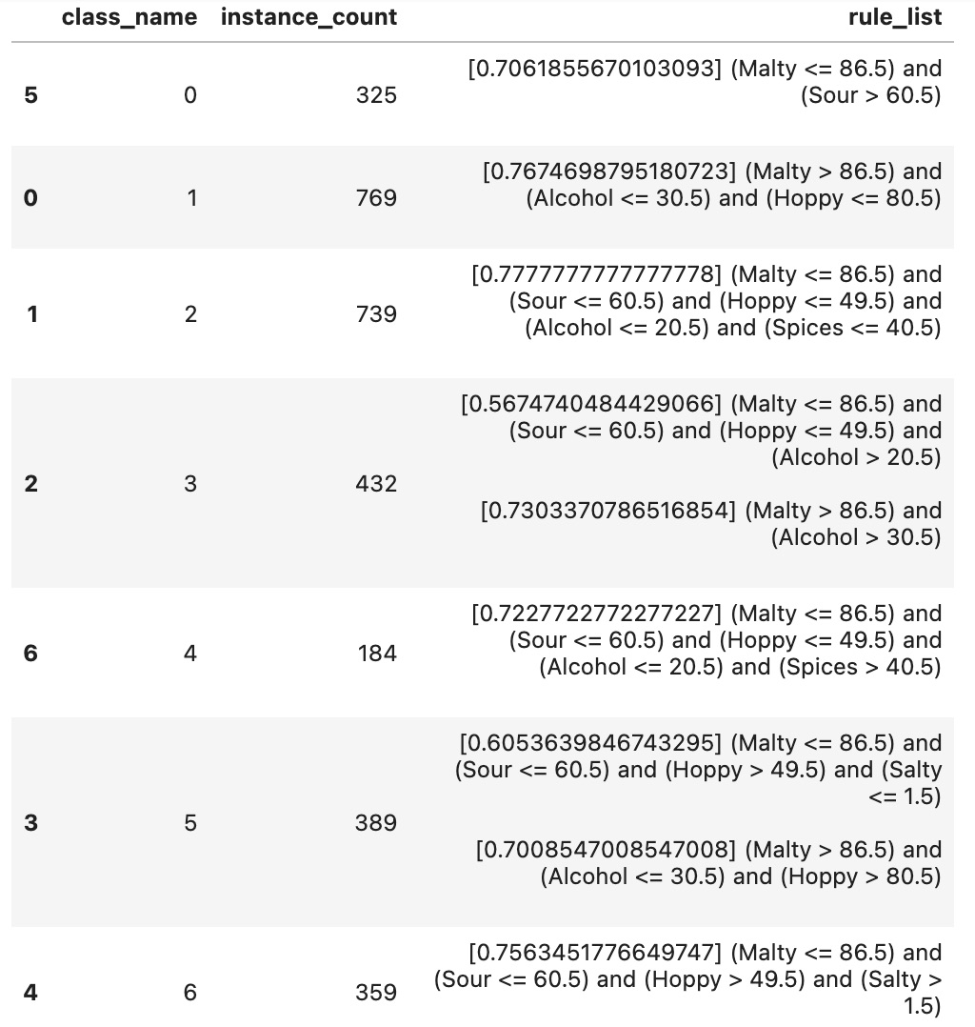
Clustering Model
Removing outside influences: Style
Optimal number of clusters: k=7
Diving into the 7 flavor profiles
Utilizing this Information
Notes:
For the purposes of the clustering model, the style variable has been removed. Style is, in essence, a manmade label for distinguishing beers. I do not want the model to be influenced by artificially created labels, only by the intrinsic qualities of the beer.
After creating a silhouette plot, I discovered that the optimal number of clusters for our data is k=7. This means that within the data, the most distinct clusters can be created if they are split up into 7 groups. Cluster membership has been assigned to each of the beers in our dataset so we can take a closer look at how these clusters are broken down.
The clustering report shown gives us a rule list that outlines the key factors for a beer to be admitted as a member of that cluster.
Cluster 0 is defined to be beers that are high in sour notes and low in malt.
Cluster 1 is comprised of beers that are malty, yet low in alcohol flavor and low in hoppiness.
Cluster 2 is made up of beers that are low in most flavor profiles, meaning they are milder in flavor (some examples in this category are non-alcoholic beer and the aforementioned “light beers” such as Bud Light and Miller Light).
Cluster 3 has two paths to membership, both requiring a high level of alcohol flavor.
Cluster 4 contains beers that are high in spicy flavors.
Cluster 5 is comprised of beers that are hoppy and sometimes malty, but not salty.
Lastly, Cluster 6 contains beers that are hoppy, not malty but indeed salty.
The classifications are definitely fascinating. Some make sense with respect to the way we typically market beers, such as Cluster 0 containing all sour beers and Cluster 4 with spicy low-alcohol beers (as an example, pumpkin beers would fall into this category). However, the last two categories that are both high in hoppiness but decided mainly by salt flavor seems like a bit of a strange distinction to a human observer.
Consumers can use the information from the clustering models to see which beers are clustered with the ones they already enjoy. This provides just a fun and interactive way to learn about new breweries or new brews from their favorite venues.
I personally am an avid sour beer drinker, so Cluster 0 would provide me with the best recommendations based on my tastes.

Slide 8
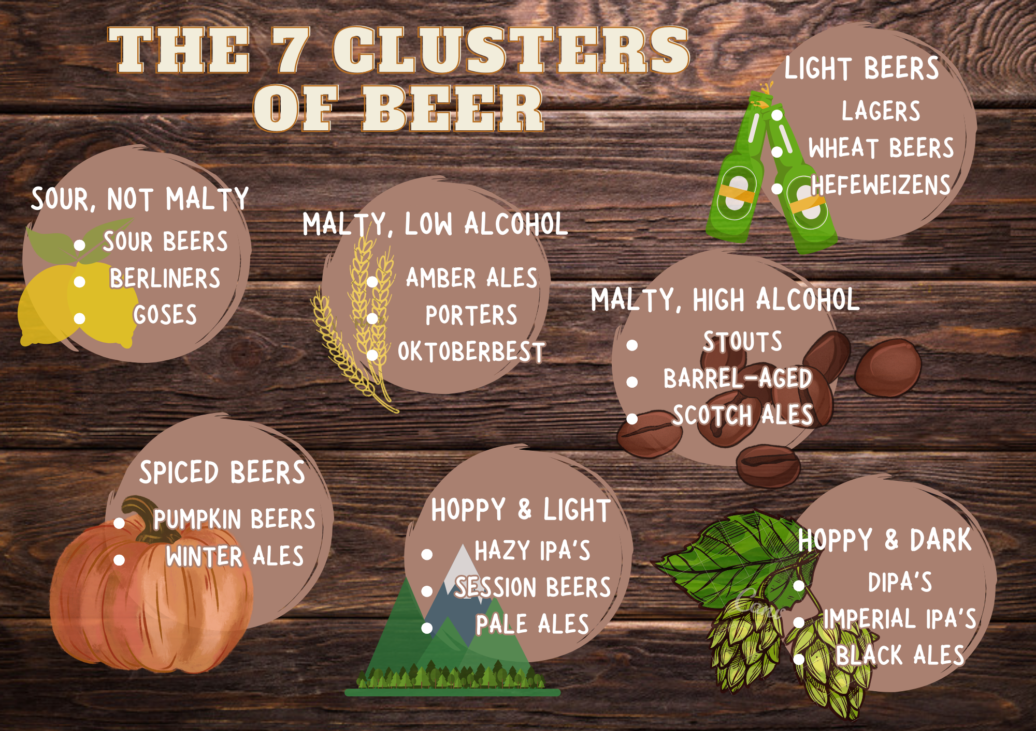

Slide 9
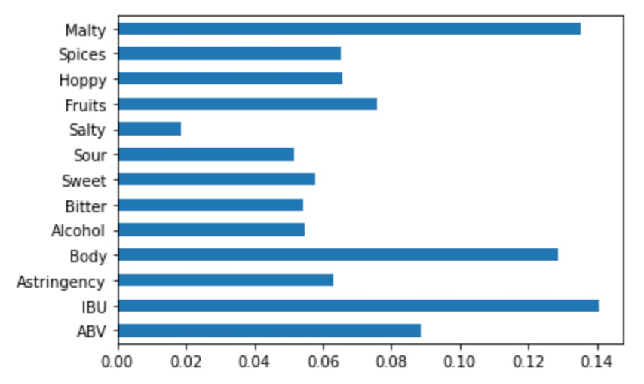
Clustering Model
Feature Importance: Determining the Most Important Factors in Clustering
IBU During the Brewing Process
Notes:
Now that we have an idea what our clusters look like, we can take a look at which features helped us the most in defining the different groups
We can see that IBU reigned as the most important feature in clustering, with maltiness and body following closely behind. IBU is a polarizing feature, with many consumers having strong feelings one way or another regarding bitterness. This likely leads to conscious efforts in the brewing process to either brew beers with high IBU or low IBU to appeal to different types of consumers. The presence of medium levels of IBU is likely less prevalent due to a lack of neutral opinions.

Slide 10
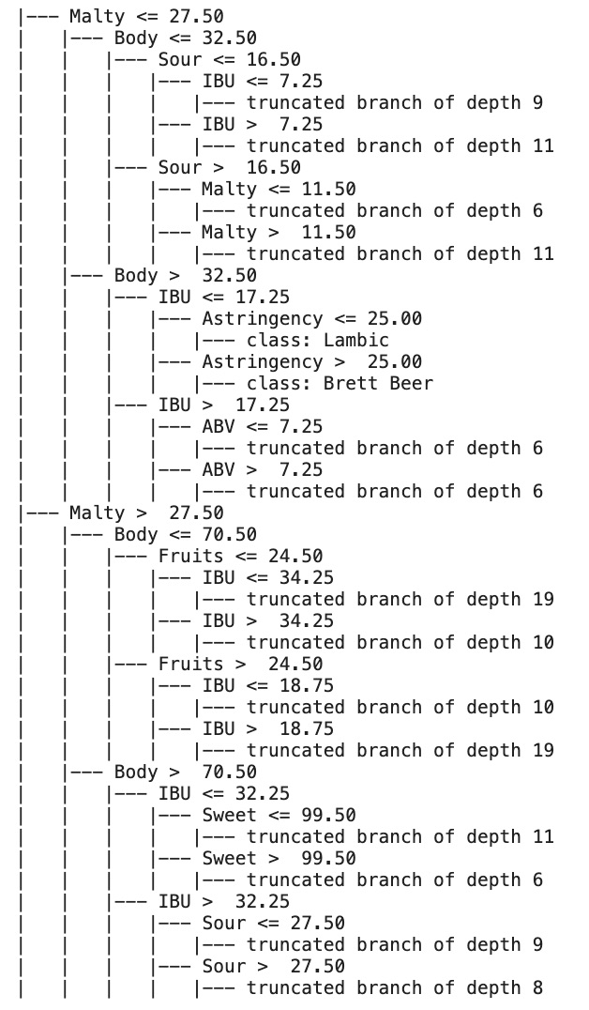
Random Forest Model
Ensemble Models and Real-Life Examples
A Single Decision Tree
How to Interpret the Tree Branches
Notes:
We will now take a look at our second model, which is a classification system intended to classify beers based on their flavor profiles. This will address our second problem statement which aims to classify beers and determine the most integral qualities to determining accurate labels.
A Random Forest Classifier is an ensemble model that pulls together information from multiple decision tree models. It is able to use the strengths of each decision tree to consolidate that information into one overall classifier system. Similar to the way a corporation has employees in different departments that focus on different tasks.
We will take a look at one of the individual decision tree models to get an understanding of the inner-workings of how they operate.
The visualization on the right shows the thought process, so to speak, of the tree as it is working to classify a beer. The top-level node distinguishes a beer depending on whether its maltiness rates higher or lower than 27.5. If it is lesser (or equal to) it will pass through the first node at the top, and then continue to be evaluated depending on is body value. If it is higher than 27.5, it will pass to the lower outer node, also continuing on to be evaluated by body score but with different bounds.
Once the beer completes its journey through the tree, it will land at a final node that tells us which style of beer it is predicted to be a member of.
The Random Forest Model will contain many of these trees, which will be specialized based on their strengths. One might be particularly good at distinguishing porters and stouts, so those beers will be passed to that particular tree.

Slide 11
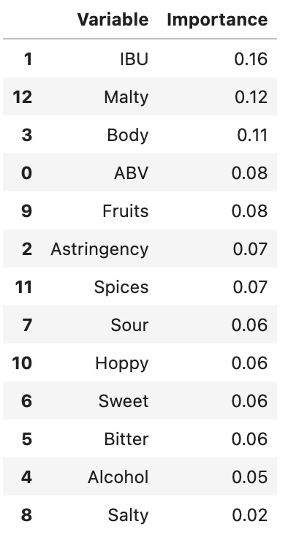
Random Forest Model
Feature Importance
Evaluating the Model
68% Accuracy
73% Weighted Avg. Precision
Real-Life Applications
Notes:
Taking a look at the feature importance for our Random Forest Model, we have the same top 3 qualities: IBU, maltiness and body. Even though these models use vastly different techniques, they still found the most value in the same dataset features.
The model itself has been pretty successful in classifying beers. As there are 43 different Styles in the data set, by pure chance there would only be a 2.3% chance of classifying a beer correctly.
Our final model has a 68% pure accuracy rate, and a 73% weighted average for precision. The precision score denotes the proportion of beers that were classified in each category that were correct, meaning a high score indicates there are few false positives.
The weighted average is higher than the macro average (which stands at 54%), meaning that we had more success with the larger categories of beer. The weighted average puts more influence on categories with more members. This tells us that our model could be improved with a vaster understanding of rarer beer styles.
Our classification data can be used by brewers who are looking for inspiration for new brews. By inputting the flavor profiles they are interested in using, the model can let them know which style is best suited for those flavors. For example, if they want to brew with pineapple and lots of hops, they can input those values into the classification model and it will let them know if the beer should be brewed as an IPA or maybe a pale ale.

Slide 12
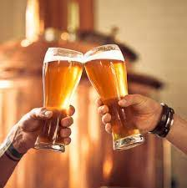
Further Research
Gathering Additional Data
Creating Recommender Systems
By Beer Similarity
By User Similarity
Notes:
Our model can be improved by gathering more data in regards to the less common styles of beer
Untappd is a crowd-sourced social media site that gathers information regarding beers thanks to customers submitting reviews, photos, and descriptions. Their API is currently closed to the public, but when it reopens, we could use it to gather larger sample sizes for some of our beer styles.
The clustering algorithm does a great job at grouping similar beers together, and may be used for recommendations for consumers as well as bartenders. However, we could expand upon this ability by creating a recommender system using cosine similarity to find the top matches for the user’s favorite beer.
If Untappd data becomes available, we could use the user information to create a collaborative user-based recommender system as well. This would allow us to find users with similar tastes to a consumer and make recommendations based off of that.

Slide 13
References
Eden, Terence. (2018, November 3). Extracting Your Data from Untappd. Terence Eden’s Blog. https://shkspr.mobi/blog/2018/11/extracting-your-data-from-untappd/
Goldfarb, A. (2018, June 1). An illustrated history of craft beer in America. First We Feast. https://firstwefeast.com/features/illustrated-history-of-craft-beer-in-america
RuthGN. (2022, March). Beer Profile and Ratings Data Set, Version 8. Retrieved March 16, 2022 from https://www.kaggle.com/datasets/ruthgn/beer-profile-and-ratings-data-set
Smith, Brad. “Making Full Bodied Beer at Home.” BeerSmith Home Brewing Blog RSS, 27 Feb. 2008, https://beersmith.com/blog/2008/02/27/making-full-body-beer-at-home/.
Waisakurnia, W. (2020, June 13). The easiest way to interpret clustering result. Medium. https://towardsdatascience.com/the-easiest-way-to-interpret-clustering-result-8137e488a127
Notes:
Thank you so much for your time today. I have included a list of the references I used throughout this project. This project has taught me an incredible amount regarding not just clustering and classification models, but also lots of interesting facts about beer and the brewing process. I learned lots of fascinating information and I hope you did as well.

